Slide 1
Specifying Quality Attribute Requirements
Note: Within complex systems, quality attributes can never be achieved in isolation.
How quality attributes can be specified
What architectural decisions will enable the achievement of particular quality attributes
What questions about quality attributes will enable the architect to make the correct design decisions.

Slide 2
Quality Attribute Expression
Stimulus: - a condition that requires a response when it arrives at a system
Source of stimulus: - some entity (a human, a computer system, or any other actuator) that generated the stimulus
Response: - the activity undertaken as the result of the arrival of the stimulus
Response measure : - when the response occurs, it should be measurable in some fashion so that the requirement can be tested
Environment: - the stimulus occurs under certain conditions
Artifact:- some artifact is stimulated: a collection of systems, the whole system, or some piece or pieces of it

Slide 3
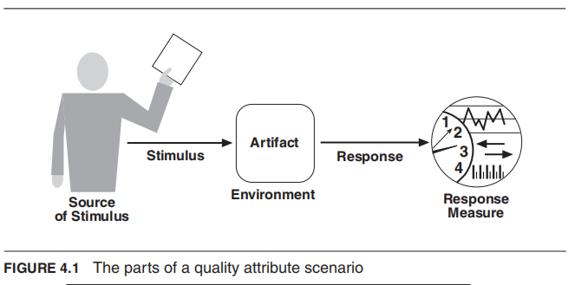

Slide 4
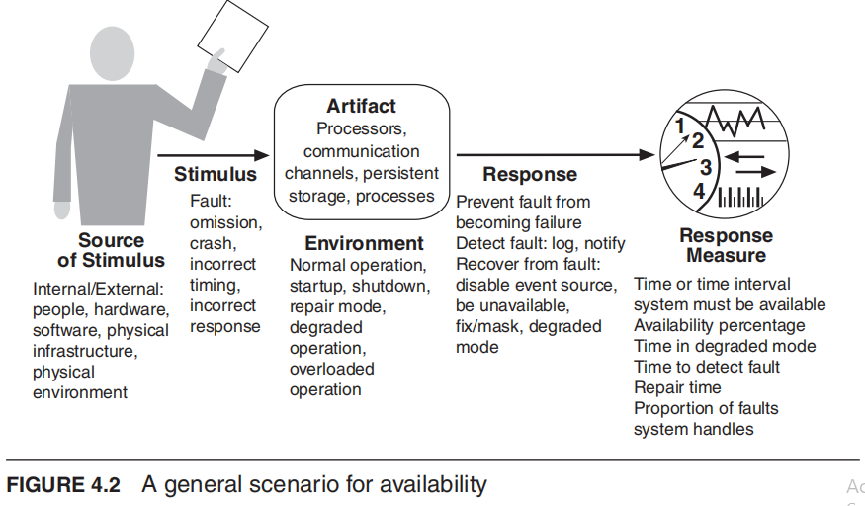

Slide 5
Quality Attribute Scenarios
General quality attribute scenarios
(aka “general scenarios” for short)
—those that are system independent and can, potentially, pertain to any system
ii. Concrete quality attribute scenarios (concrete scenarios)
—those that are specific to the particular system under consideration.

Slide 6
Achieving Quality Attributes through Tactics
The quality attribute requirements specify the responses of the system that, realize the goals of the business.
How can an architect achieve the required quality attributes?
Architectural tactics:
- These are techniques an architect can use to achieve the required quality attributes.
A tactic is a design decision that influences the achievement of a quality attribute response
—Tactics directly affect the system’s response to some stimulus.
- Tactics impart portability to one design, high performance to another, and integrability to a third.
Note: The focus of a tactic is on a single quality attribute response.
Within a tactic, there is no consideration of tradeoffs.

Slide 7
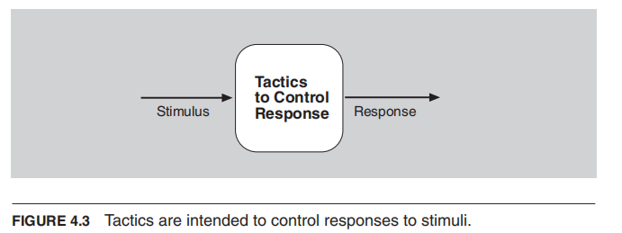
Represent the Relationship between Stimulus, Tactics, and Response

Slide 8
Why Architectural Tactics?
Tactics is what architects do in practice.
There are three reasons:
Design patterns are complex; they typically consist of a bundle of design decisions. But patterns are often difficult to apply as is; architects need to modify and adapt them.
2. Tactics give the architect insight into the properties of the
resulting design fragment.
3. By cataloging tactics, we provide a way of making design more
systematic within some limitations.

Slide 9
Summary
Architectural patterns can be seen as “packages” of tactics.
The seven categories of architectural design decisions are these:
1. Allocation of responsibilities
2. Coordination model
3. Data model
4. Management of resources
5. Mapping among architectural elements
6. Binding time decisions
7. Choice of technology

